Slide 1

SILAC
Team members:
1-هلا ياسر محمد عبد الجواد (سكشن 8)
2-هدير فيصل منير امير (سكشن 8)
3-وفاء حمادة عبد الجليل عبد الرحيم (سكشن 8)
4- اسراء عادل علي عبد المتجلي (سكشن 1)
5-اسراء محمد عبد اللاه احمد (سكشن 1)
6-ريم مصطفي راشد عبد العال (سكشن 4)
7- ندي حامد حسن احمد (سكشن 7)
4 Bioinformatics department
Supervision:
أ.د/ ابراهيم العوضي

Slide 2
Introduction:
Stable isotope labeling by amino acids in cell culture (SILAC) is a technique based on mass spectrometry that detects differences in protein abundance among samples using non-radioactive isotopic labeling, it has become one of the most popular labeling techniques for MS-based quantitative proteomics and powerful method to study the relative proteomic change under differential treatments, which relies on the mass spectrometry and the metabolic incorporation of amino acids with substituted stable isotopic nuclei.
SILAC:
SILAC-based quantitative proteomics is an innovative service used in high throughput quantitative analysis of large protein complexes, chemical biology, biomarker discovery and protein-protein interactions.

Slide 3
- It is an acronym that stands for Stable Isotope Labeling with Amino acids of Cells in culture.
In SILAC, a given 'light' or 'heavy' form of the amino acid is incorporated into two samples.
Two cell populations are grown in culture media that are identical except that one of them
contains a 'light' and the other contains a 'heavy' form of a particular amino acid.
- This approach provides an unbiased strategy that can reveal how specifically either inhibitors,
or other perturbations, affect the dynamic properties and/or cellular distributions of proteins.
It can also be used as a sensitive and effective method to determine the specific interaction
partners of proteins under study. Although the technology is currently being used in basic
investigative research mainly on continuously growing cell lines
SILAC has generally been regarded as unsuitable for plant systems, mainly due to poor
metabolic labelling efficiency, which affects the accuracy of quantification of peptide ratios. To
date, there are only two reports of SILAC labelling in plant systems, both using Arabidopsis cell
cultures, which were labelled with ca. 80% and 83–91% efficiency, respectively, making
quantitation complex

Slide 4
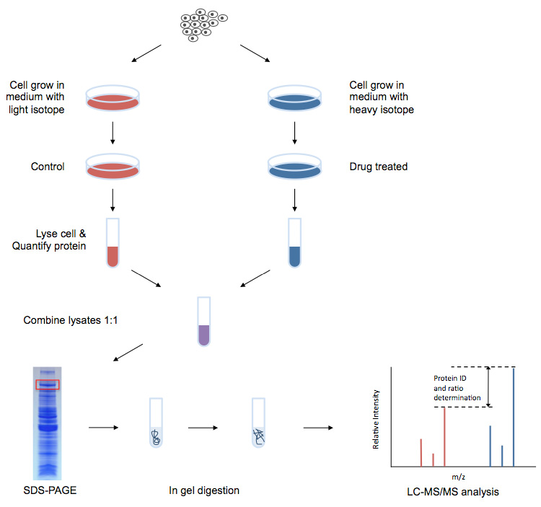
The workflow of SILAC :
1) Adding light, medium or heavy stable isotope-labeled essential amino acids (mainly lysine and arginine) to the cell , and through the normal metabolism of the cell, the newly synthesized proteins are all tagged with stable isotopes.
2) Mixing all types of protein in equal amounts and after separation , and enzyme digestion, LC-MS / MS analysis can obtain quantitative and qualitative results of related proteins

Slide 5
Advantages of SILAC-based Proteomics Analysis :
High labeling rate : The labeling efficiency is not affected by lysate and efficiency can
be as high as 100%.
High sensitivity : The sample requirements are small, usually only tens of micrograms of protein per sample.
High throughput : Mass spectrometry can identify and quantify hundreds to thousands of
proteins simultaneously.
High precision : Multiple samples are mixed, simultaneously digested, and identified. The subsequent experiments have the same effect on the sample, which reduces the impact of experimental operation and equipment, and has higher precision and reproducibility.

Slide 6
Disadvantages of SILAC-based Proteomics Analysis :
- Time consuming culture process.
- Some samples cannot be obtained through culture processes
- Some cell types cannot accommodate certain amino acids.
- Suboptimal labelling efficiencies of autotrophs can affect sensitivity and accuracy of quantitation of
proteins.
SILAC experiment:
Adaptation phase (untreated cells, heavy vs. light)
Adaptation phase experiment allows the cells to adapt to the SILAC medium and evaluates the degree of incorporation of the heavy amino acid over time. An aliquot of cells from only the heavy sample is analyzed. It is unnecessary to perform extensive fractionation of proteins before the analysis at this stage.
A mixture of peptides from a gel band is analyzed by LC-MS , several peptides are selected , and the m/z region corresponding to the light form of each peptide is examined.

Slide 7
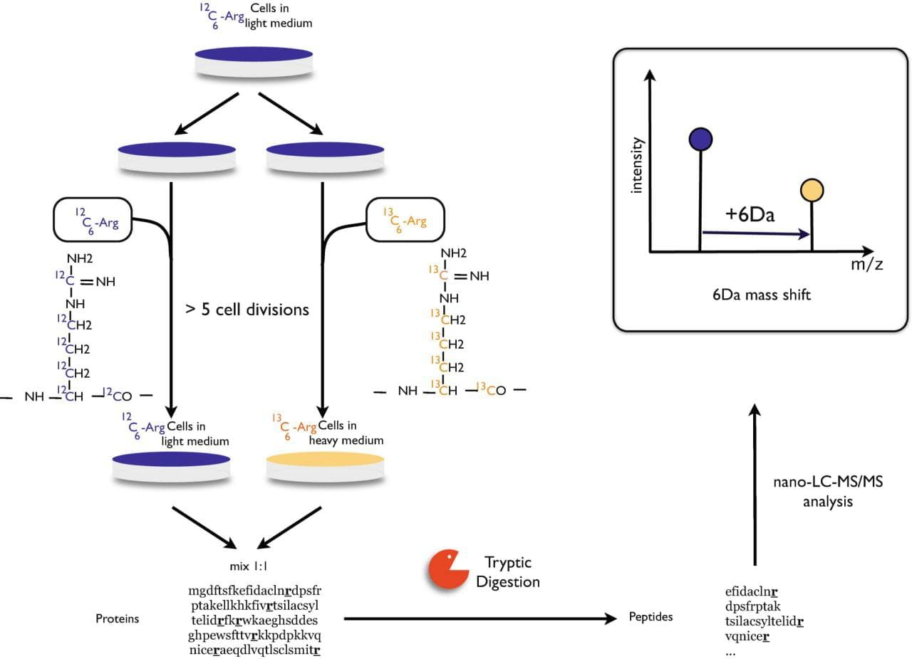
In the final SILAC analysis, the proportion of proteins in the fully labeled ‘heavy’ state must be >98%, it means that no detectable signal should be present in the m/z region of the ‘light’ form of a peptide.

Slide 8
Experiment phase (differential treatment, heavy vs. light)
Once the heavy amino acids are fully incorporate,
two cell populations (from adaptation phase) can undergo a differential treatment.
for example a drug is added to the ‘light’ population and the ‘heavy’ population is left untreated (control).
The experiment follows the protocol that has been optimized during the pilot study. The outcome of the SILAC experiment is a record of quantitative and qualitative changes in the cell protein profile in response to the treatment.

Slide 9
Applications
A SILAC approach involving incorporation of tyrosine labeled with nine carbon-13 atoms (13C) instead of the normal carbon-12 (12C) has been utilized to study tyrosine kinase substrates in signaling pathways.
SILAC has emerged as a very powerful method to study cell signaling, post translation modifications such as phosphorylation, protein–protein interaction and regulation of gene expression.
SILAC has become an important method in secretomics, the global study of secreted proteins and secretory pathways. ​It can be used to distinguish between proteins secreted by cells in culture and serum contaminants.
Standardized protocols of SILAC for various applications have also been published.
While SILAC had been mostly used in studying eukaryotic cells and cell cultures, it had been recently employed in bacteria and its multicellular biofilm in antibiotic tolerance, to differentiate tolerance andsensitive subpopulations.

Slide 10
THANK YOU

